Slide 1
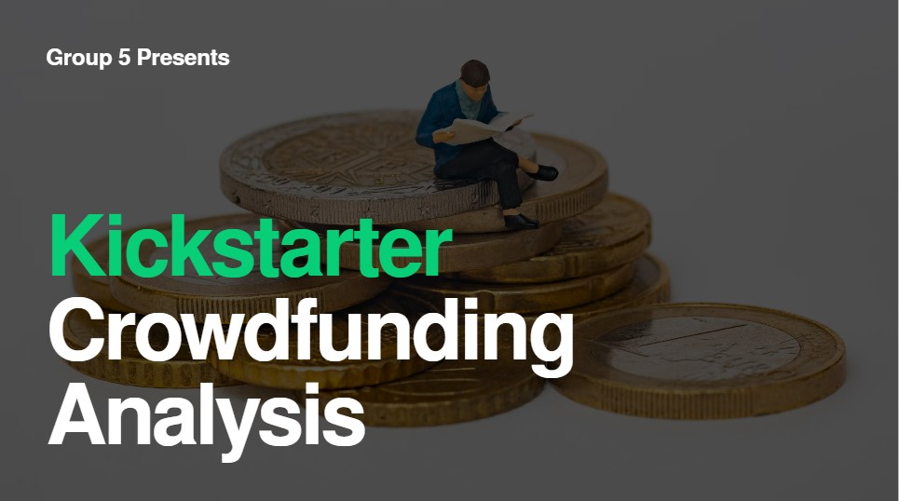

Slide 2

Gundeti Rahul
Team Members
Swapnil Bhagawan Tengale
Chandrika Sri Ratna Dasari
Srujan Narlawar
Kore Nisha Rani
Ratnam Veera Mohan Kumar Kranthi Kumar Madham

Slide 3

Agenda
Introduction
01
Data Overview
02
Objectives & KPls
03
Dashboard Snapshots
04
Process Workflow
05
Data Analysis
06
Recommendations & Insights
07
Conclusion
08

Slide 4

Introduction
Kickstarter serves as a premier crowdfunding platform, connecting innovators, artists, and creators with potential backers. It empowers individuals to bring their creative ideas to life by securing financial support from a global community.
Through data analysis, we uncover key patterns that explain why some projects succeed while others fall short. These insights help creators make informed, strategic decisions to improve the likelihood of campaign success.
The primary objective of this analysis is to examine Kickstarter campaign data to extract meaningful insights. These insights aim to guide future campaigns toward higher funding success through data-driven strategies.

Slide 5

Data Overview
The dataset is sourced from Kickstarter's public data, covering campaigns from 2009 to the present. This long-term range provides a comprehensive context for analyzing trends and campaign performance over time.
With over 300,000 projects recorded, the dataset offers a robust and diverse foundation for evaluating a wide variety of funding campaigns across multiple categories and regions.
The dataset includes essential attributes such as:
Project Name, Category
Funding Goal
Amount Pledged
Number of Backers
Campaign DurationCountry / Location
Campaign Outcome (Successful / Failed / Canceled)

Slide 6
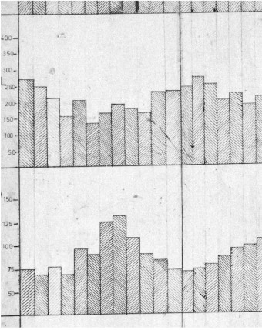
Objectives & KPIs
Strategic Objectives:
The primary goal of this analysis is to identify the key factors that drive campaign success on Kickstarter. This involves evaluating how different categories and geographic regions perform relative to each other, helping uncover the elements that influence successful outcomes across diverse project types.
Key Performance Indicators (KPls):
To measure and analyze campaign performance, the KPIs used are:
Success Rate (^{O}/o)— The percentage of campaigns that achieved or
exceeded their funding goals
Average Pledged Amount — The mean value of funds raised per
campaign
Median Campaign Duration — The most common campaign length in
days
Number of Backers — The average number of supporters per project
Pledge-to-Goal Ratio — A metric showing how efficiently campaigns reach their funding targets

Slide 7
Dashboards
01
Crowdfunding Analysis Project
An infographic highlighting the crowdfunding analysis project with sections for overview, project outcome percentage, and detailed project outcomes.
02
Overview Dashboard
A comprehensive dashboard summarizing total projects, raised amounts, goals, and backers. It includes project outcomes by status, geographical distribution, and trends over time.
03
Project Outcome Percentage Analysis Dashboard
A dashboard focusing on percentages of successful
projects by goal range, category, year, month, and quarter, providing insights into performance metrics.
04
Project Outcome Analysis Dashboard
A detailed dashboard analyzing successful
projects, including top categories, most funded projects, average days to success, and leading locations by amount raised.

Slide 8
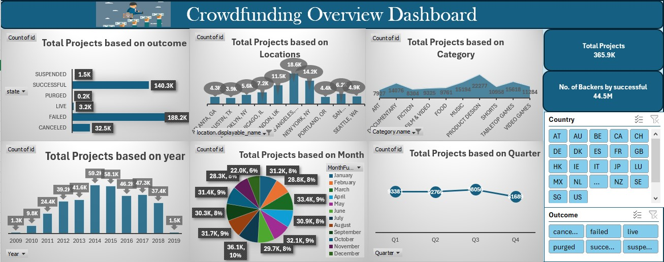
Excel Dashboard 1

Slide 9
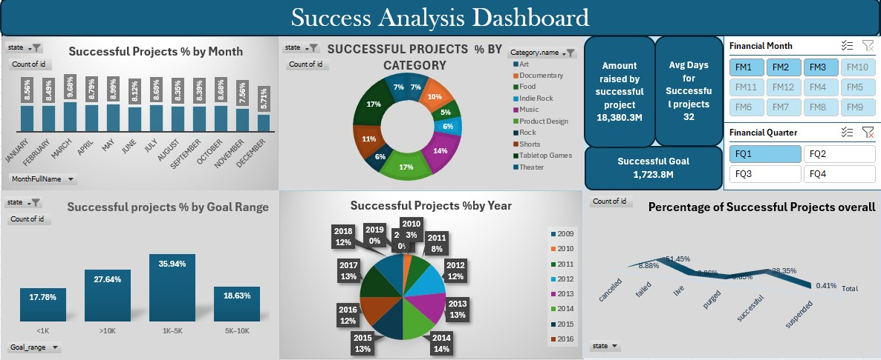
Excel Dashboard 2

Slide 10
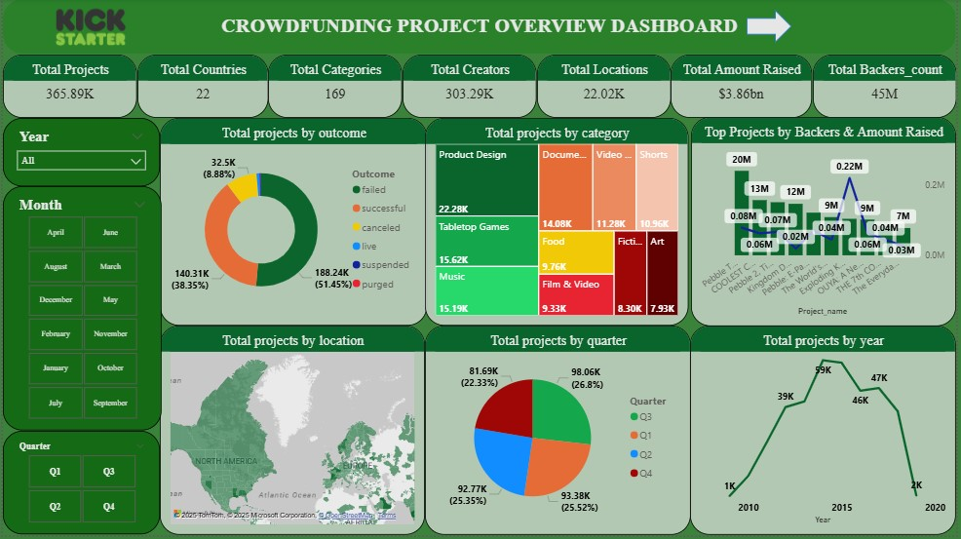
Power-BI Dashboard 1

Slide 11
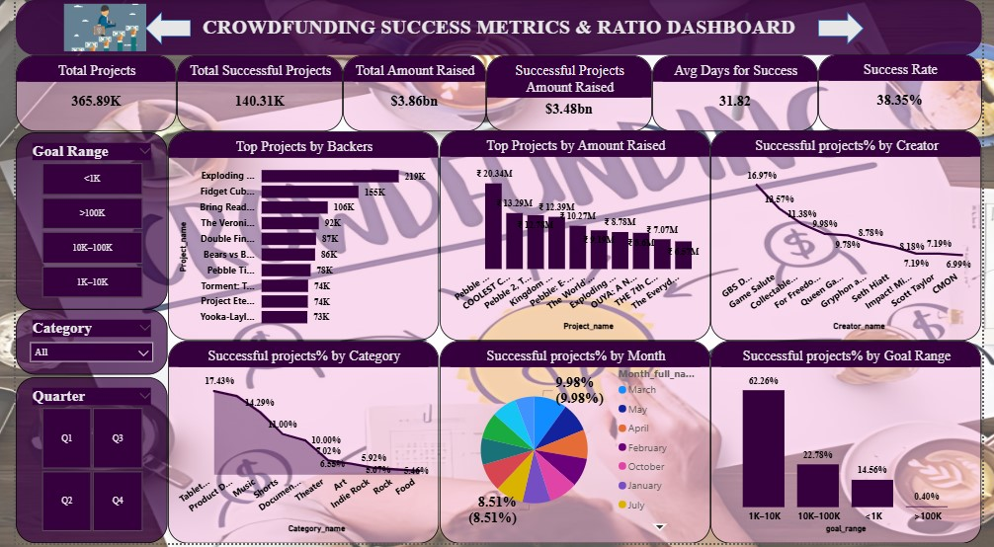
Power-BI Dashboard 2

Slide 12
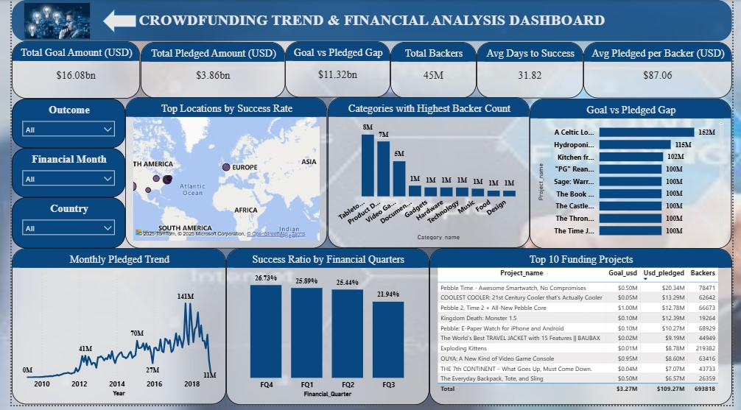
Power-BI Dashboard 3

Slide 13
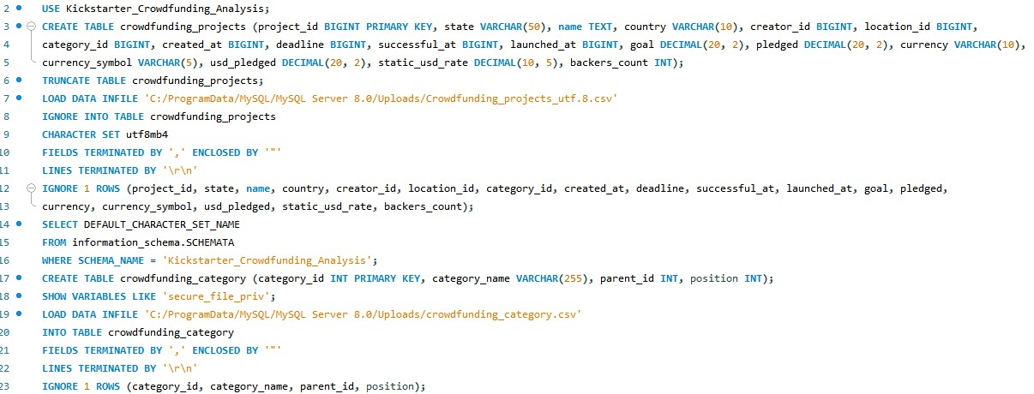
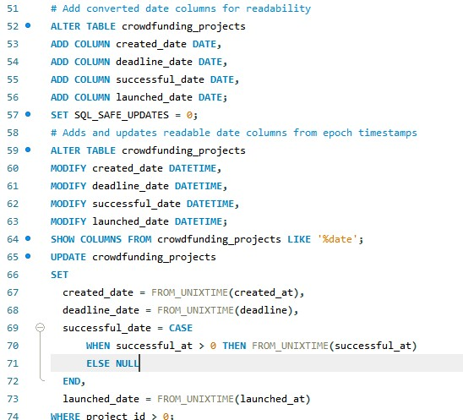
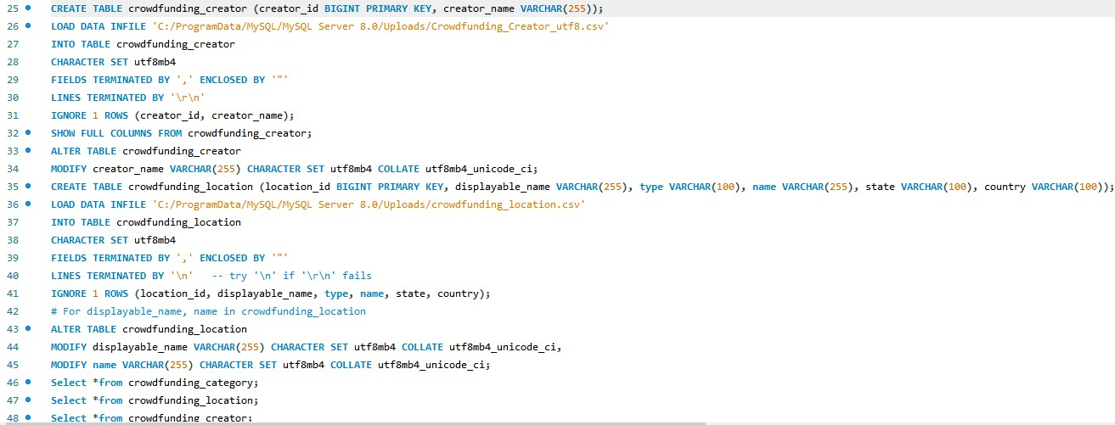
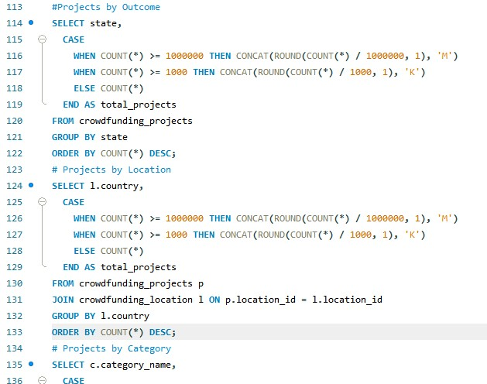
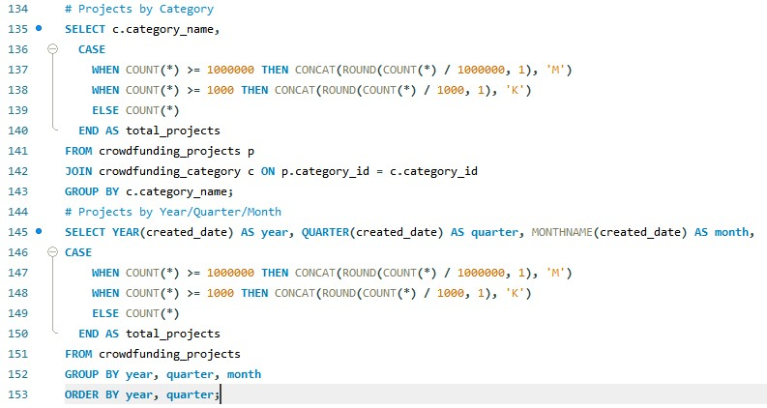
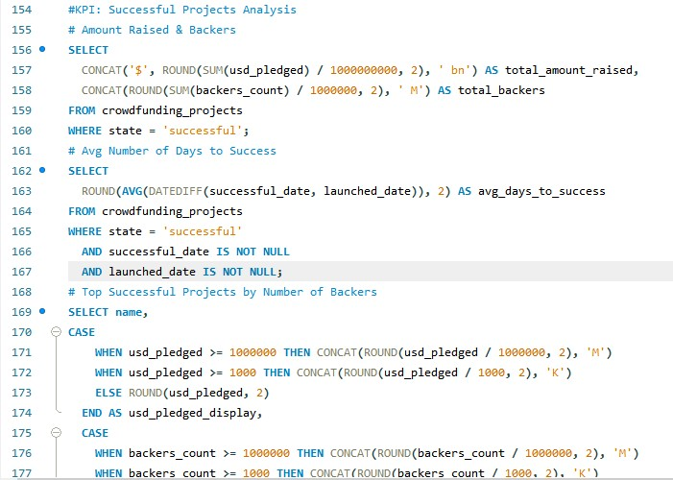
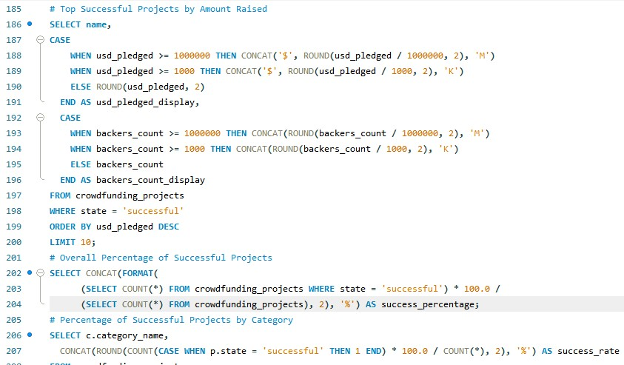
My SQL

Slide 14
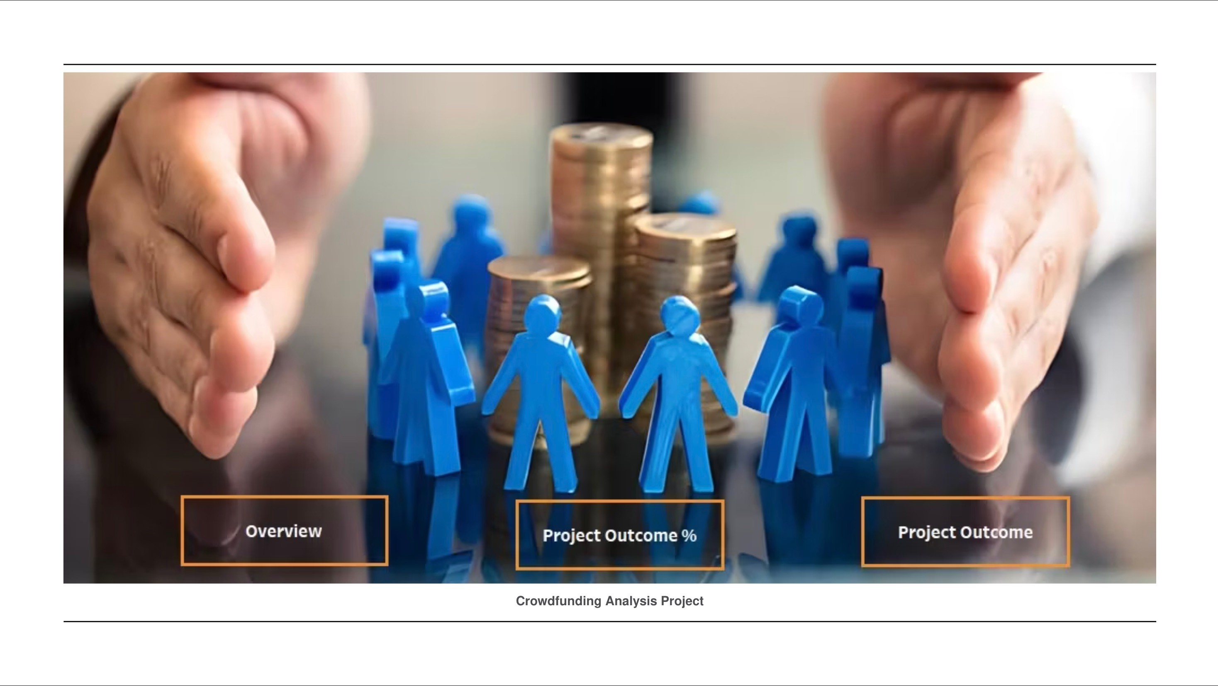

Slide 15
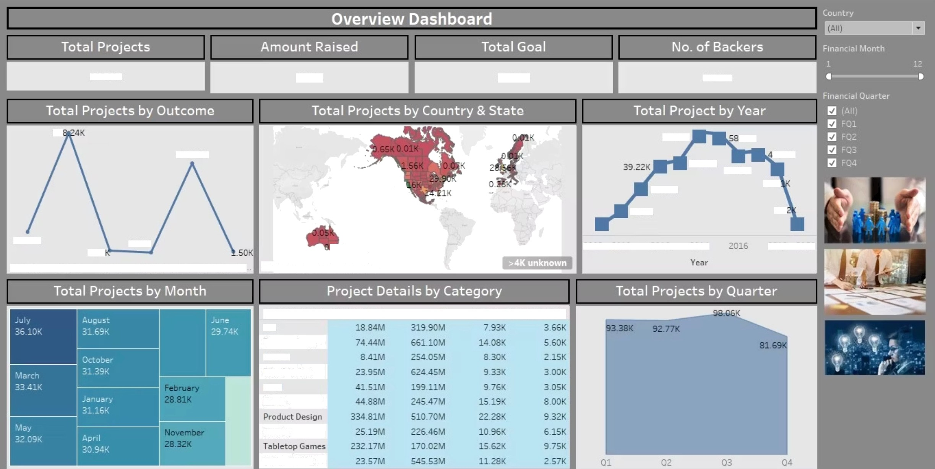

36S.89K
$1.72B
$12.70B
44.52M
18
S9.16K
.10K
140.31K
41.S6X
7.27K
s1J
46.16K
24.36K
37.4’
1.19K
9.84K
1.S
32 OK
3.16
Iive
0.18K
2008 2010 00 2 2014
20 8 20?0
canceled
’a iled
purged
successfu I suspend
6 2025 Mapbox6 OpenStreetMap
name (crowdfu.. Amount Rais..
Art
Documentary
Fiction
Fil m 8 Video
Food
Music
Goal
Projects Successful p..
ShO IS
Video Games
Overview Dashboard

Slide 16
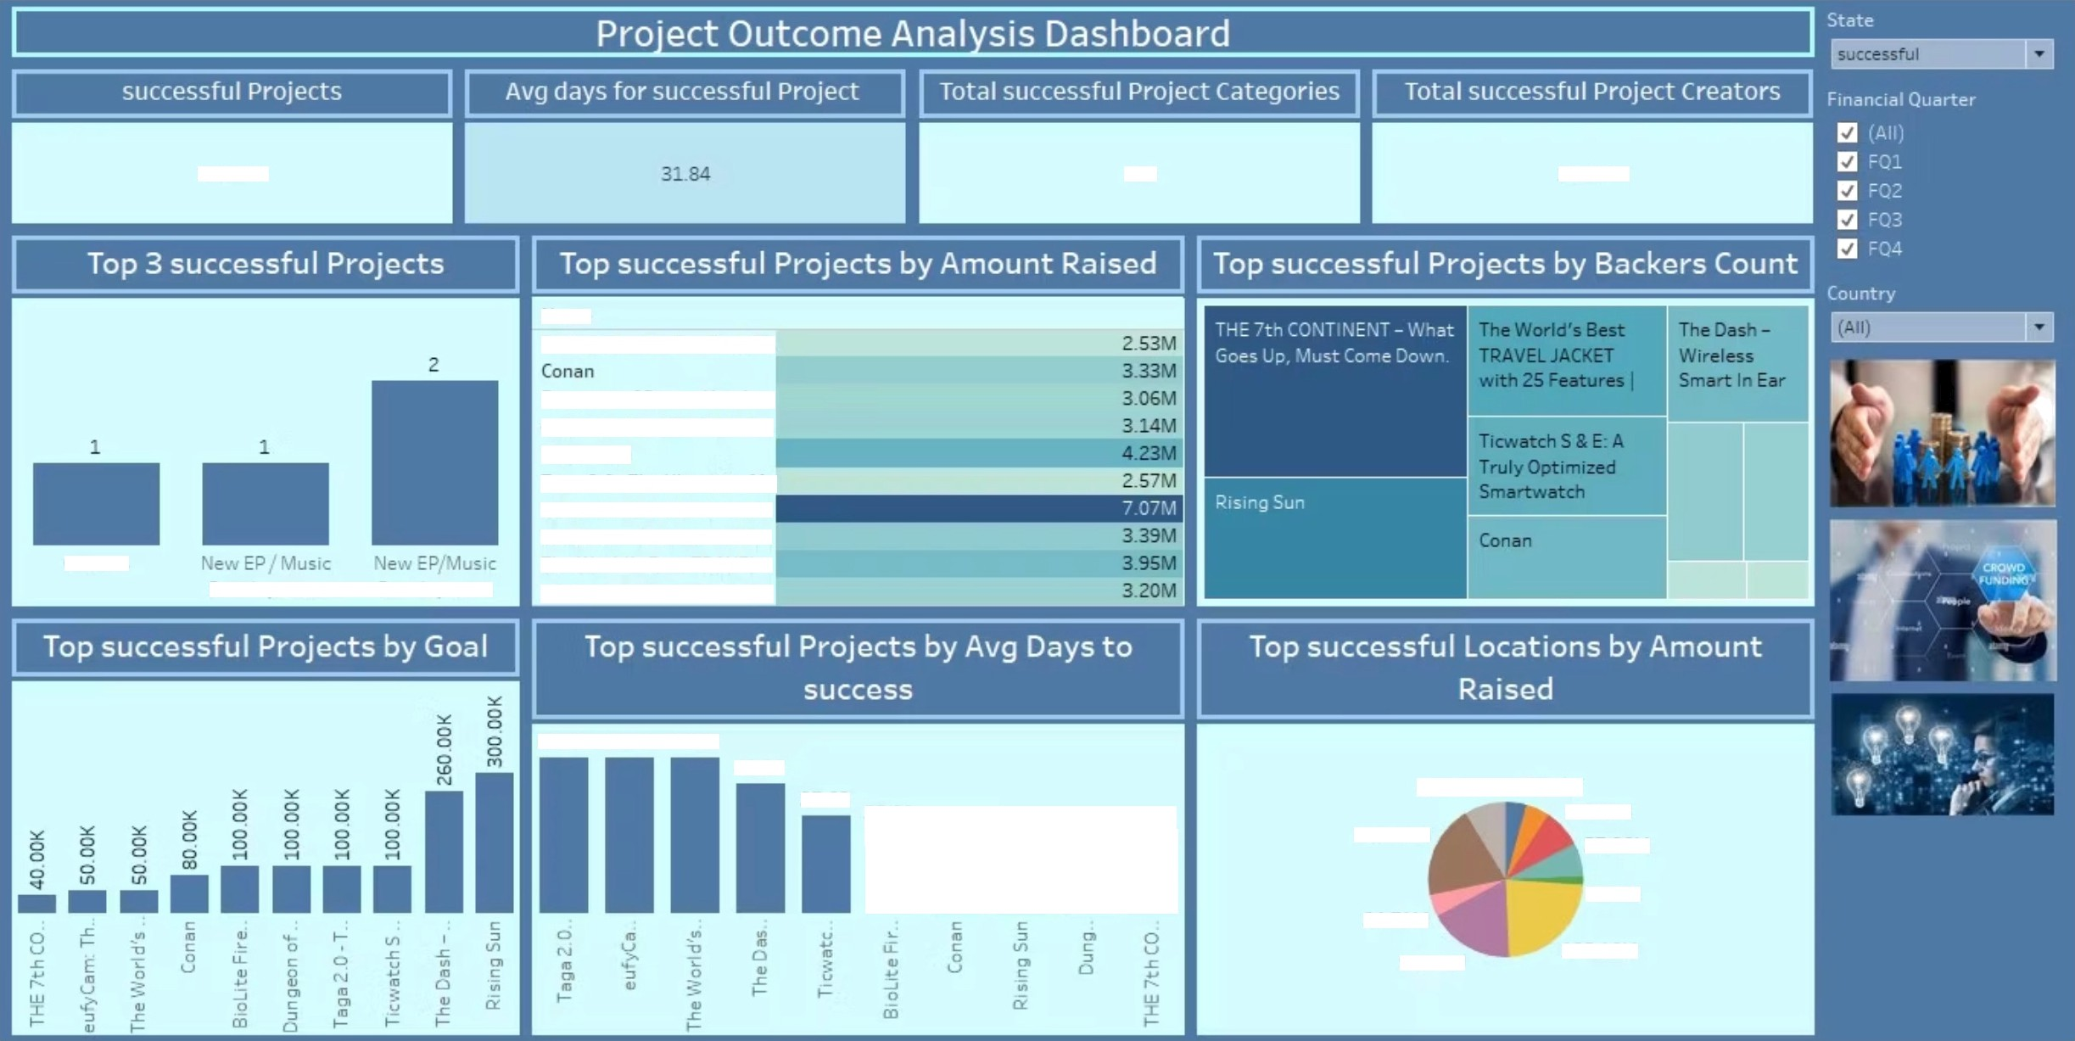





140.31K
169
112.71K
Name
BioLite FirePit: See Fire, N..
Dungeon of Doom: Handcr.. eufyCam. The Wirefree Se.. Rising Sun
Taga 2.0 - The Ultimate. M..
THE 7th CONTINENT - Wh..
The Dash - Wireless Smar.. The World's Best TRAVEL .. Ticwatch S & E: A Truly Op..
Choirs
De. elooment
De'. elone ent
60.00 60.00 S9.96
49.96
37.63
3220
46.91M
23.21M
43.18M
37.96M
27.33
24.42
23.17
10S.20M
24.7IM
9.58M
96.S1M
12S.16M
Project Outcome Analysis Dashboard

Slide 17
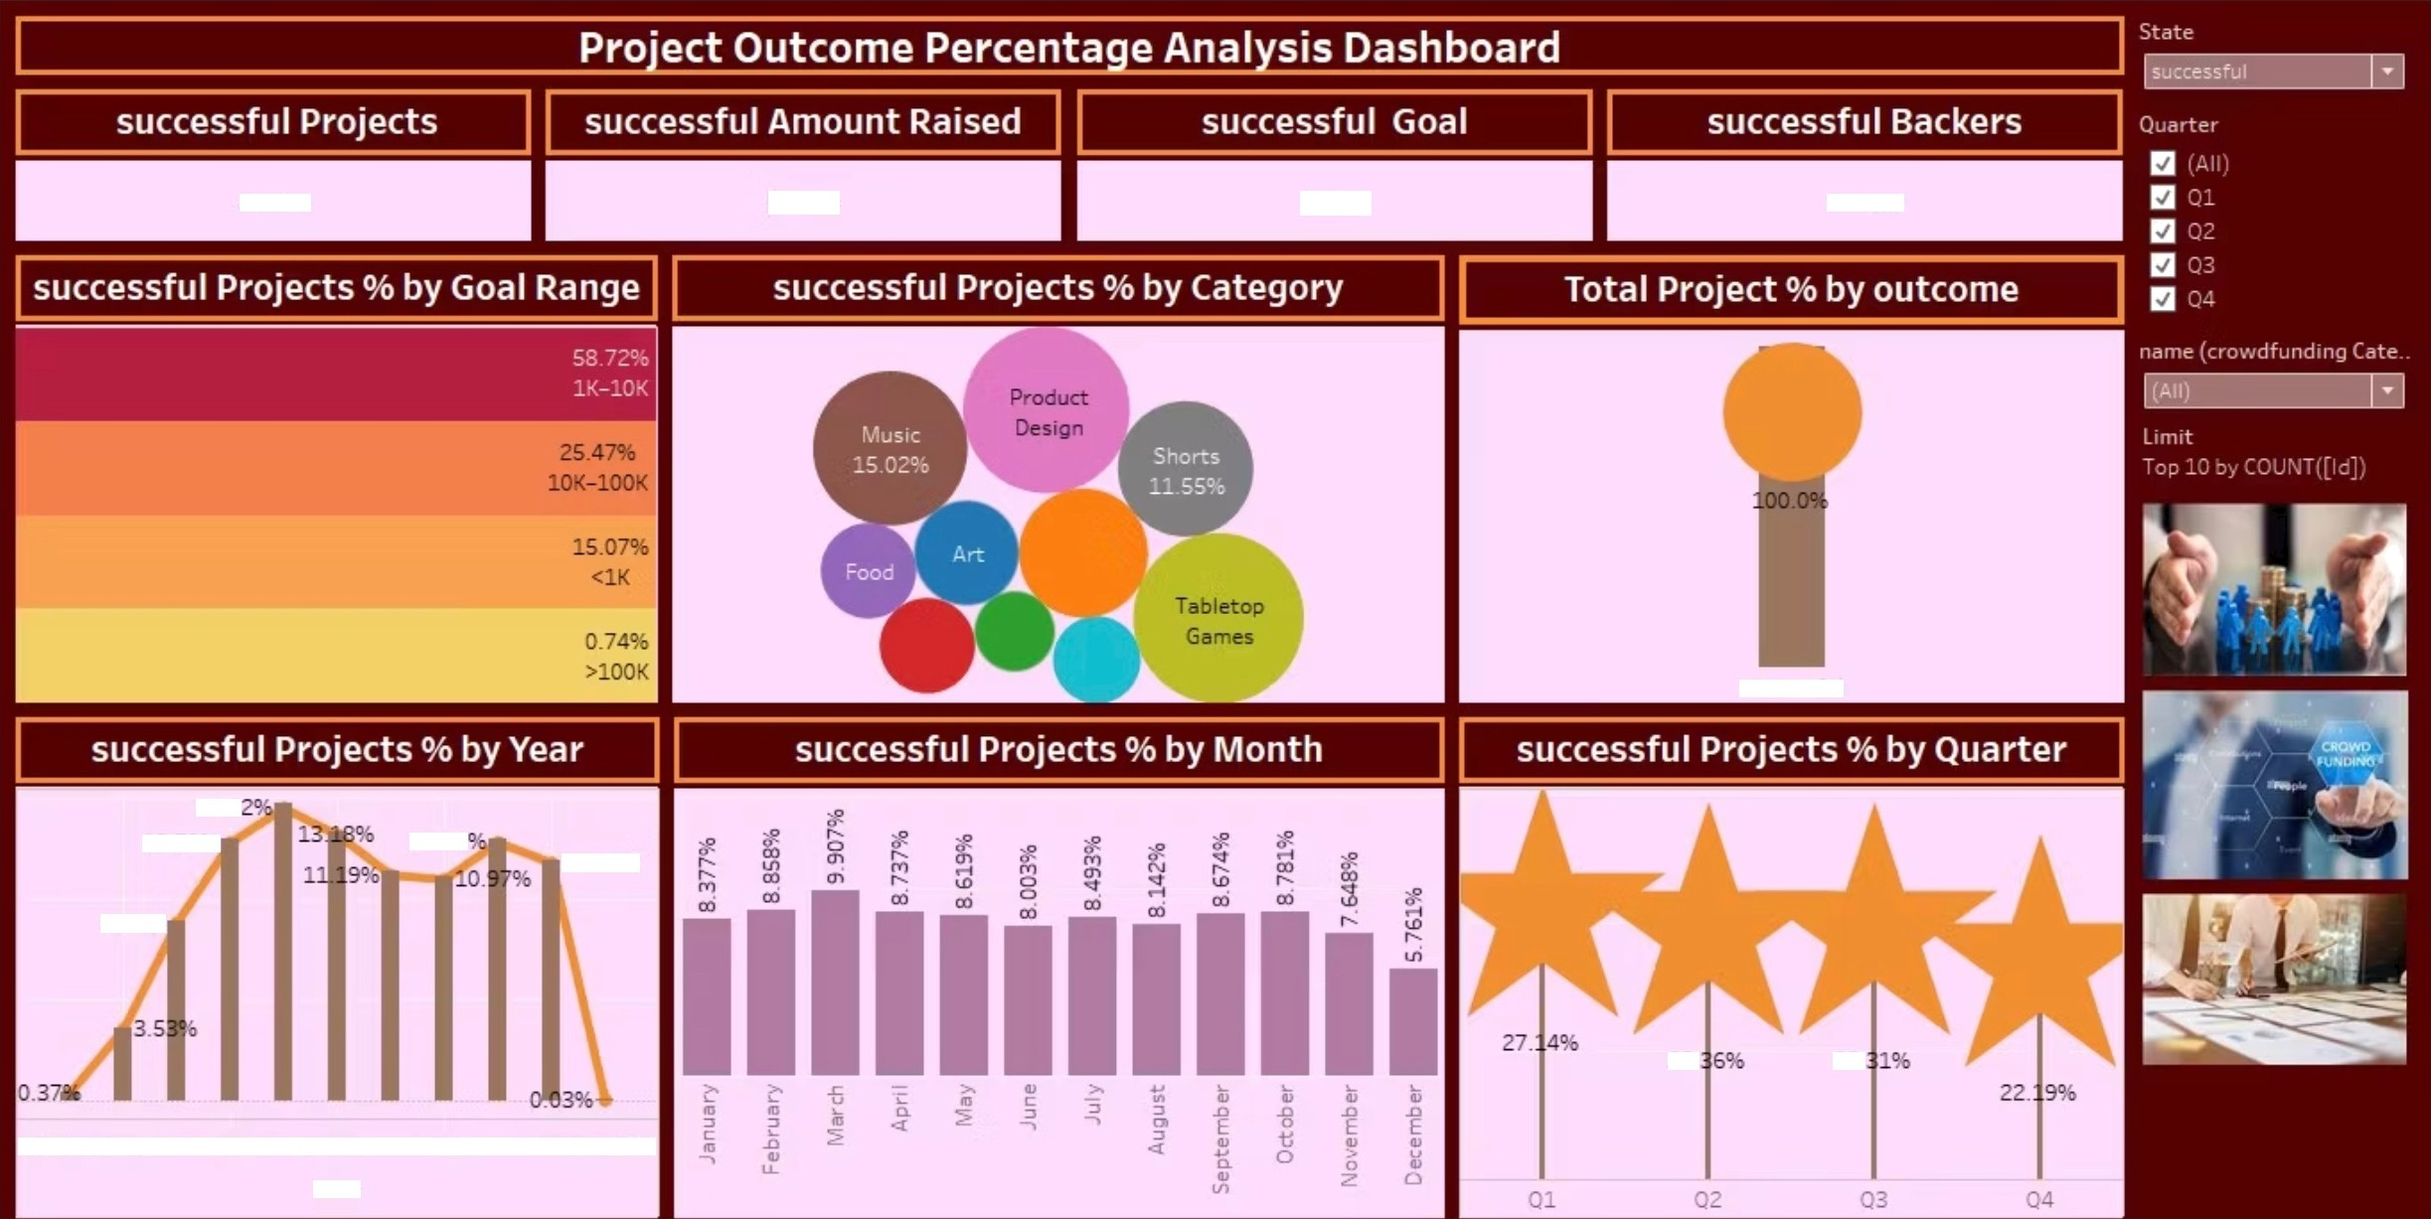

53.25K
$0.73B
$0.SOB
22.38M
14.S
12.799
12.81
11.7996
8.81%
25.
25.
2008 2010
2012
2014
2016
2018 2020
Project Outcome Percentage Analysis Dashboard

Slide 18
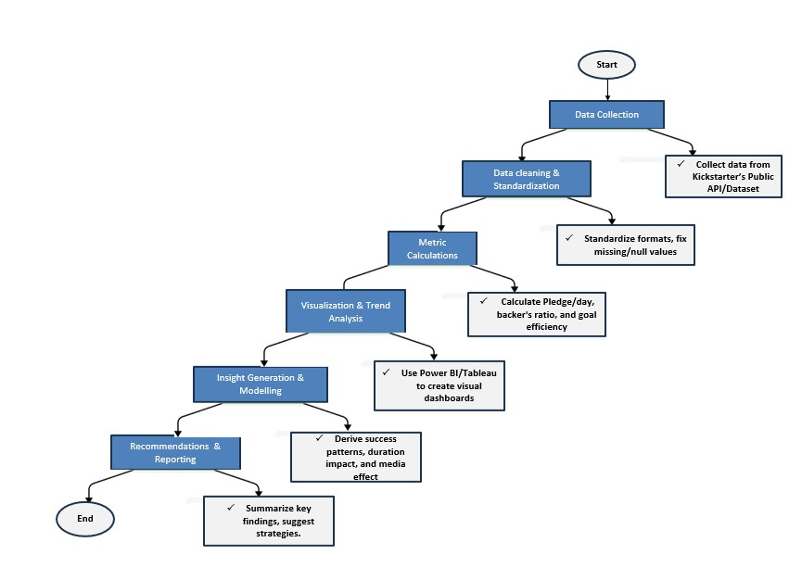
1. Data Collection
Process Workflow
Gather comprehensive data from Kickstarter's public dataset
Ensure inclusion of both historical and recent campaigns
Capture key attributes like goal, pledged amount, backers, category, etc.
2. Data Cleaning & Standardization
Remove duplicates and handle missing values
Standardize inconsistent formats (e.g., dates, currencies)
Ensure data accuracy and readiness for analysis
Metric Calculations
Compute core metrics such as:
Pledge per day
Backer-to-goal ratio
Campaign success rate

Slide 19
Process Workflow
4. Visualization & Trend Analysis
Use tools like Power BI or Tableau for dynamic visualizations
Identify trends across categories, countries, and time periods
Highlight relationships between goals, duration, and outcomes
5. Insight Generation & Modeling
Analyze patterns in successful vs. failed campaigns
Assess impact of factors like media use, timing, and funding goals
Derive insights to guide campaign strategy
6. Recommendations & Reporting
Summarize key findings in a clear, actionable format
Suggest data-driven strategies for improving
campaign success
Prepare visuals and written insights for
stakeholder presentation

Slide 20

Data Analysis
Identifying Categories
The data reveals clear trends across project categories.
While Technology, Games, and Design dominate in terms of volume,
the highest success rates are observed in more niche categories such
as Dance, Theater, and Comics. This suggests that less crowded
categories may offer better opportunities for campaign success.
Average Pledge Insights
Campaigns that utilize visual media such as videos, high-quality images, and prototypes tend to receive significantly higher pledge amounts. This highlights the importance of engaging content in building trust and attracting potential backers.
Optimal Duration
Campaigns lasting between 30 to 35 days show the highest success probability.
This duration appears to strike the right balance between visibility and
urgency, maintaining backer interest without causing campaign fatigue.

Slide 21

Recommendations & Insights
Set Realistic Funding Goals
Avoid overly ambitious targets that may deter potential backers.
Campaigns with attainable and clearly justified goals tend to build
trust and encourage contributions.
Optimize Campaign Timing
Data suggests that launching campaigns in the middle of the
week, especially on Tuesdays, leads to higher engagement. This
aligns with peak periods of backer activity and platform traffic.
Boost Engagement with Media & Updates
Use compelling visuals (videos, infographics, photos) and provide regular campaign updates to keep backers informed and emotionally invested. High engagement often correlates with higher
pledge totals.

Slide 22


Conclusion
Success Drivers
Kickstarter campaign success is closely linked to strategic goal-setting, timely launches, the use of engaging media, and smart category selection. These elements consistently distinguish high-
performing campaigns.
Leveraging Data
Data-driven insights form the foundation for repeatable success.
By identifying patterns from past campaigns, creators can shape strategies that are informed, targeted, and far more likely to resonate with backers.
Creative Strategies
Combining creativity with analytics not only improves campaign performance but also strengthens long-term engagement. This approach fosters trust and sustainability, making crowdfunding
efforts more impactful over time.

Slide 23


